Slide 1
Unit 10: For Live Session Assignment

Slide 2
Part 1: Quick Quiz Questions

Slide 3
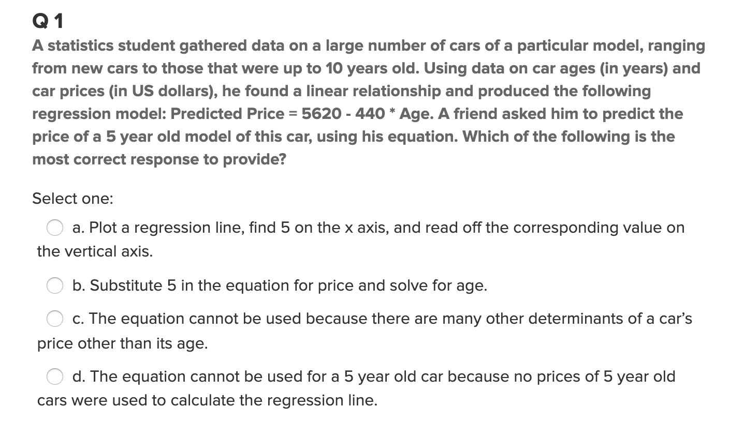
Part 1: Quick Quiz Questions

Slide 4
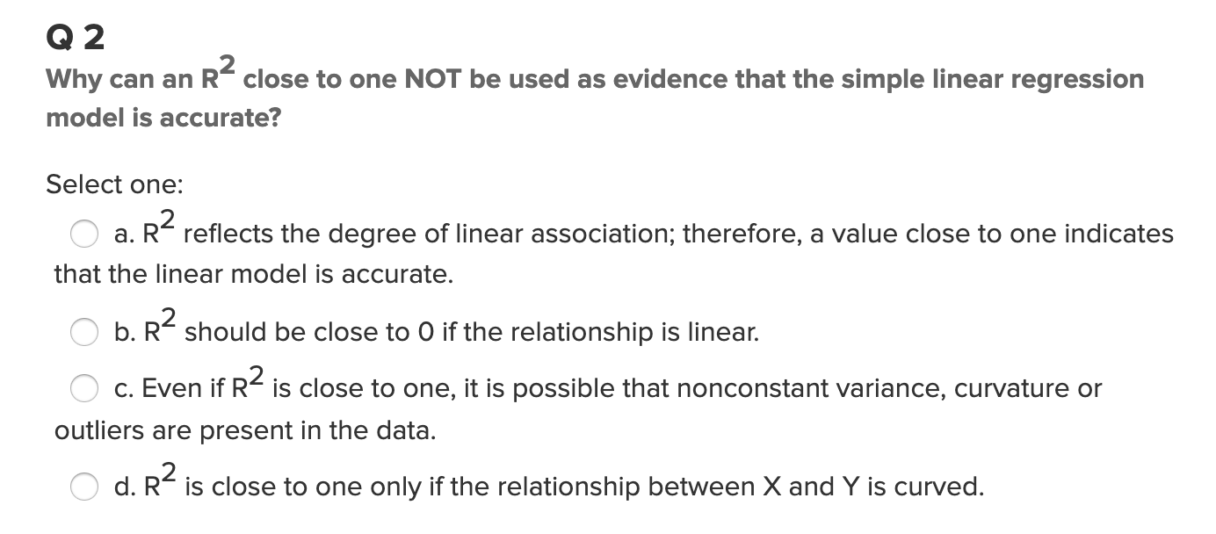
Part 1: Quick Quiz Questions

Slide 5
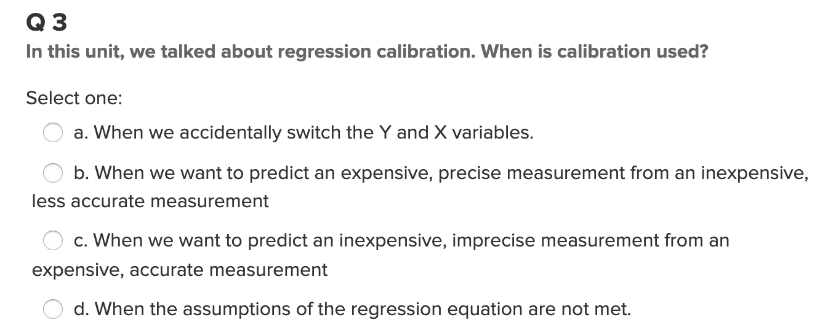
Part 1: Quick Quiz Questions

Slide 6
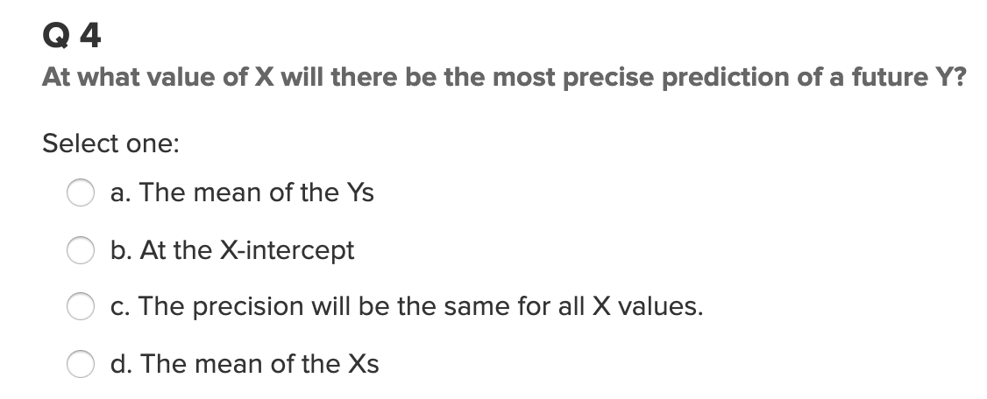
Part 1: Quick Quiz Questions

Slide 7
Part 2: Lack of Fit Test

Slide 8
Lack of Fit Test
Month | Sales
1 | 2.678969
1 | 6.452194
1 | 1.837394
1 | 6.108601
1 | 5.369281
2 | 1.766862
2 | 6.898837
2 | 1.579677
2 | 3.726494
2 | 8.953184
3 | 8.680436
3 | 9.931636
3 | 6.691443
3 | 11.39723
3 | 14.93447
A company wants to look at sales volume (in $M) for various stores for three different months. Perform a lack of fit test (at significance level 0.05) to determine if the separate means model (using three parameters) is significantly better than the linear regression model (using two parameters).
You may want to copy the blank ANOVA table on paper.
DO NOT plug the data into any software.
Source | df | SS | MS | F | Pr > F

Slide 9
Part 3: Takeaways

Slide 10
Please Provide a summary of at least 4, but as many any as you like, takeaways from this unit!

Slide 11
Part 4: Questions or Comments

